Slide 1


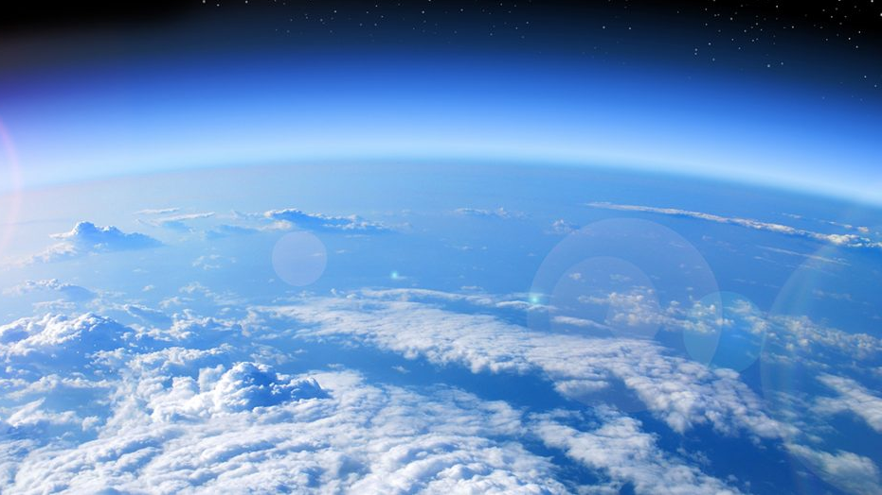
Prediction of skewed biased Ozone Days
By: Shamil, Richard, Raphael
3253 –Machine Learning
Date: December 03, 2019

Slide 2


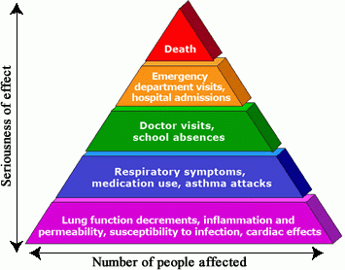
Background & Motivation
Ozone is a gas composed of three atoms of oxygen (O3)
Protects us from the sun’s ultraviolet rays
Breathing it can trigger a variety of health problems
Formed from sophisticated physical and chemical reactions
Motivation:
We want to build an ozone level alarm forecasting model for air
quality experts
Notes:
Breathing ozone can trigger a variety of health problems including chest pain, coughing, throat irritation, and airway inflammation. It also can reduce lung function and harm lung tissue. Ozone can worsen bronchitis, emphysema, and asthma, leading to increased medical care.

Slide 3

Data Nature
Ozone level dataset provided by Texas Commission of Environmental Quality
Covers the geographic areas of Houston, Galveston and Brazoria
Time series data ranging from 1998-2004
Dataset consists of 74 sparse features, relatively small training size, skewed classes (6% ozone days vs 94% normal days)
Possibly, many irrelevant features that will need to be eliminated or reduced via dimensionality reduction

Slide 4
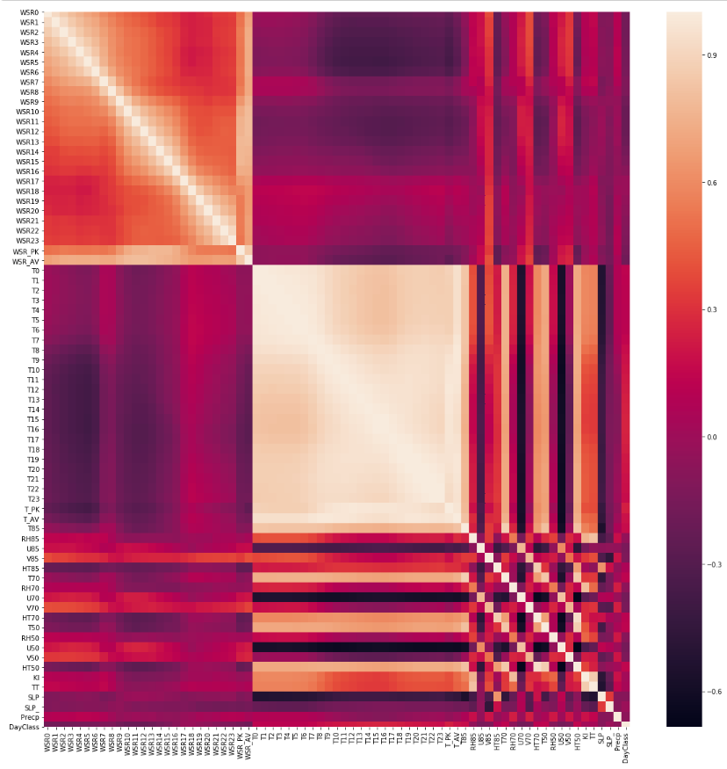
Correlation Heat Map

Slide 5
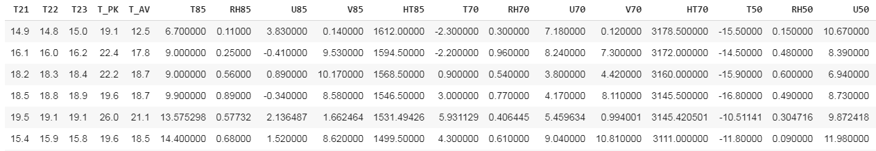
Scrubbing
Train test split with stratify - high volume of data that is labelled as normal date
Transformed data with MinMax - independent variable value varies from small decimals to few thousands
No missing data

Slide 6
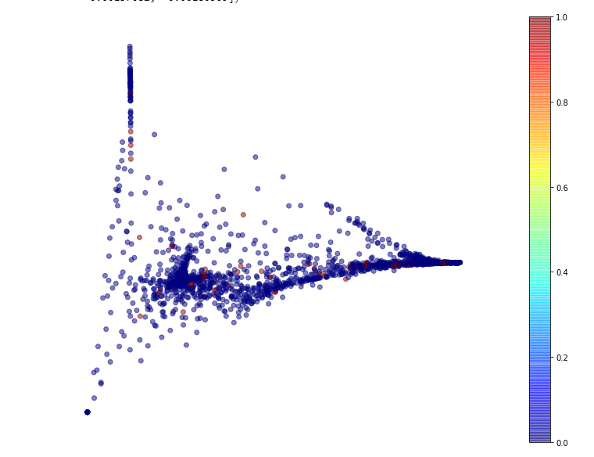
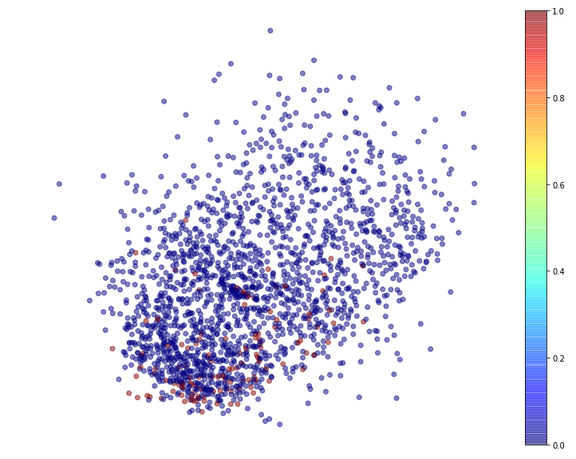
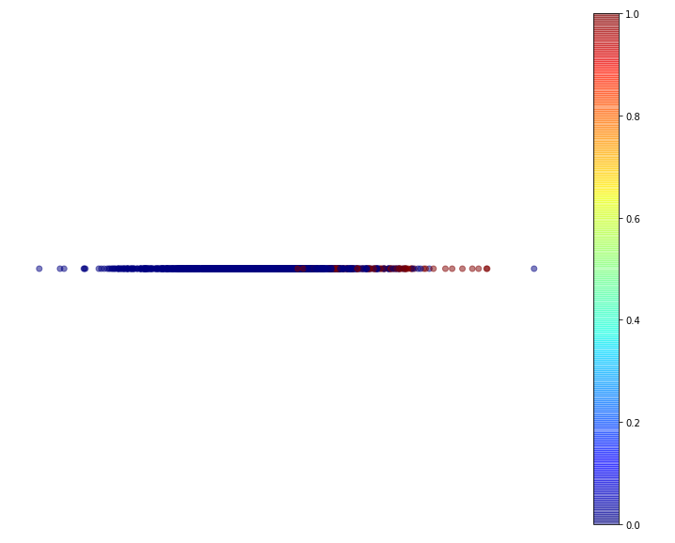
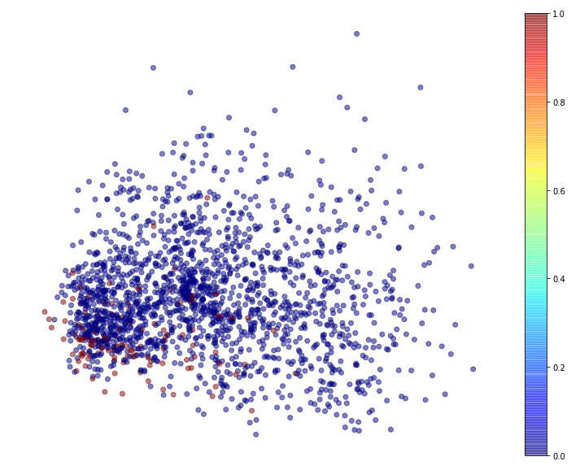
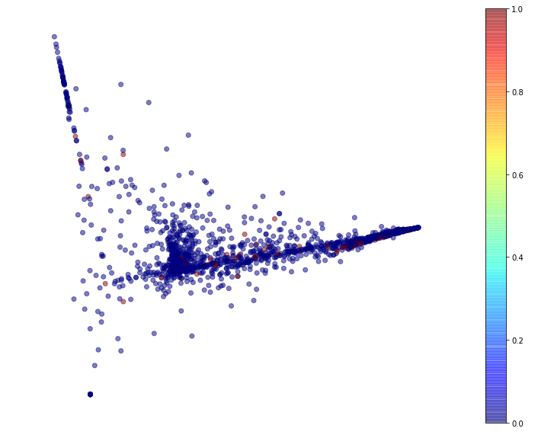
Dimensionality Reduction
Top row (left - right): Locally Linear Embedding,
Multi-Dimensional Scaling,
Linear Discriminant Analysis
Bottom row (left - right): Principal Component Analysis,
Principal Component Analysis + Locally Linear Embedding
The one that provided the best result is LDA
Notes:
Most of the reds are on the right side of the line.

Slide 7
Modelling
Compared the performance of the following classifiers
LogisticRegression
GaussianNB
KNeighbors Classifier
Decision Tree Classifier
Random Forest Classifier
SVC
SGD Classifier
Voting Classifier (Ensemble of all other classifiers except Neural Network)
Neural Network Classifier

Slide 8
Modelling
 | Logistic Regression | Gaussian NB | KNeighbors Classifier | Random Forest Classifier | Decision Tree Classifier | SVC | SGD Classifier | Neural Network | Voting Classifier
Accuracy | 0.944737 | 0.944211 | 0.943684 | 0.923158 | 0.923158 | 0.946842 | 0.942105 | 0.958947 | 0.947895
Precision | 0.620214 | 0.613547 | 0.577273 | 0.396936 | 0.396936 | 0.717857 | 0.572849 | 0.578056 | 0.671958
Recall | 0.300000 | 0.300000 | 0.383333 | 0.366667 | 0.366667 | 0.275000 | 0.483333 | 0.602778 | 0.350000
F1 | 0.392481 | 0.390592 | 0.456364 | 0.376343 | 0.376343 | 0.382776 | 0.505170 | 0.567156 | 0.451475
AUC | 0.644101 | 0.643820 | 0.682397 | 0.663670 | 0.663670 | 0.633567 | 0.728184 | 0.000000 | 0.669101

Slide 9
PREDICTION
 | Gaussian NB | Logistic Regression Classifier | Neural Network Classifier | Voting Classifier
Precision | 0.613547 | 0.620214 | 0.578056 | 0.671958
Recall | 0.300000 | 0.300000 | 0.602778 | 0.350000

Slide 10

Conclusion
It is important for use to make sure we can predict as many Ozone Days as possible.
This is because of the health effects due to the Ozone.
Hence, we have chosen to use the Neural Network even though we have a lower precision compared to some of the other
 | Gaussian NB | Logistic Regression Classifier | Neural Network Classifier | Voting Classifier
Precision | 0.613547 | 0.620214 | 0.578056 | 0.671958
Recall | 0.300000 | 0.300000 | 0.602778 | 0.350000

Slide 11
Reference
Zhang K, Fan W, Yuan X (2008). Forecasting skewed biased stochastic ozone days: analyses, solutions and beyond, Knowledge and Information Systems. Department of Computer Science, Xavier University. Retrieved from http://citeseerx.ist.psu.edu/viewdoc/download?doi=10.1.1.435.8329&rep=rep1&type=pdf

